Slide 1

A Spring in your Step
Fundamentals to picking up Spring
Shane Burroughs

Slide 2
Goals
Overview of Spring Framework
Deeper dive into specific modules
Spring Boot
Spring MVC
Spring Data
Spring Security
Questions and Live Spring Demo

Slide 3

Spring Framework A Summary
The Spring Framework is a Java platform that provides comprehensive infrastructure support for developing Java applications. Spring handles the infrastructure so you can focus on your application.
Notes:
Summary pulled from documentation.
Spring is the glue/plumbing to your application code

Slide 4
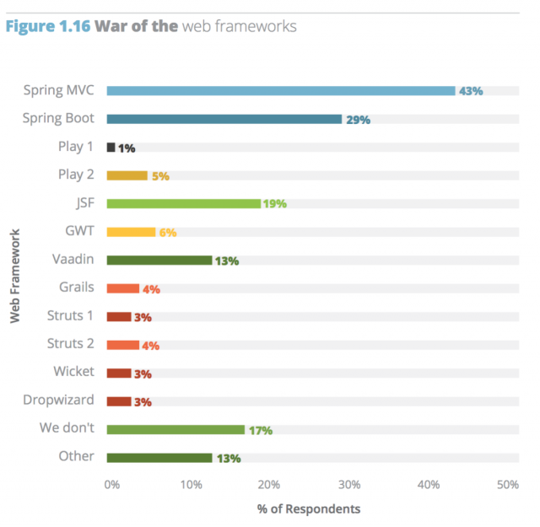
Spring Framework (Adoption)
The most popular enterprise Java application framework
Apache Licensed, Open Source Software
Long standing history of adoption
Spring 1: 2002
Spring 5: Q2 – 2017
Notes:
Bar chart of most popular java frameworks of 2016 from zeroturnaround
-https://zeroturnaround.com/rebellabs/most-popular-java-frameworks-tools-and-libraries-2016/

Slide 5
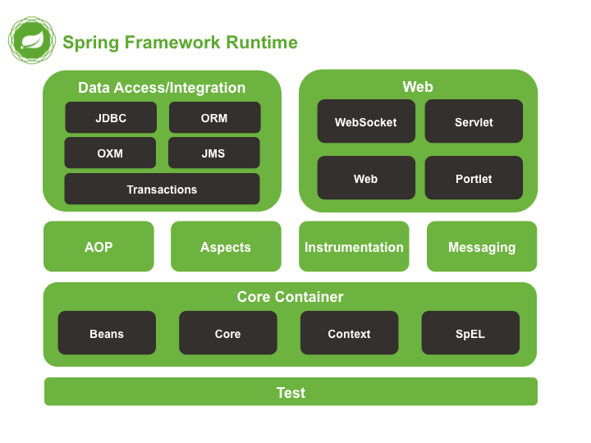
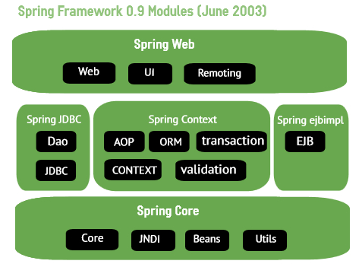
Why Spring Framework
Enforces best practices
Simplifies Code
Light Framework
Development Support
Notes:
Enforces best practices
-code to THEIR API
-coding to interface
-extend not modify
Simplifies Code
- Few lines of code to do a lot
Light Framework
-Pojo Based
-Not overly complex to integrate into application
Development Support
-Documentation, image below
-Spring today not always spring of tomorrow. Always improving

Slide 6
Spring Limitations
Too bloated for small applications
Difficult to learn and master
Older versions rely heavily on xml configuration
Documentation always evolving
Notes:
Too bloated for small applications
-Not libraries or bare bones performance (limited performance overhead)
Difficult to learn and master
-Scope of which it covers is HUGE
Older versions rely heavily on xml configuration
Documentation always evolving

Slide 7
Personal Take
Steep learning curve if you’re not already familiar with modern design paradigm
Learn something new every time I work with it.
I will likely adopt Spring framework for most personal projects going forward
Notes:
For the Average Developer?

Slide 8

How do I use it
https://spring.io/guides
Copy + Paste
????
PROFIT!!!
Notes:
https://spring.io/guides:
-Give overview of level of support provided by Spring.
-hello world apps
-e.g. Consuming a restful resource in angular

Slide 9
How do I use it (Seriously)
Start small and use just what you need
Spring is modular by design
Import the spring dependencies of choice into your project
Maven, Gradle, etc…
Implement your Spring based Application
A lot of default behavior. . .RTFM
Notes:
Import modules specific to application at hand.

Slide 10
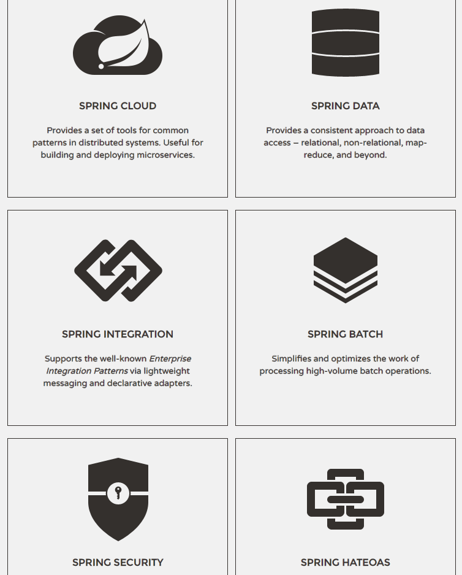
Projects
https://spring.io/projects
Spring Boot
Spring Data
Spring Security
Spring Social
Spring LDAP
Spring Kafka
Spring AOP
Etc…
Notes:
Helps with a lot of common use cases

Slide 11
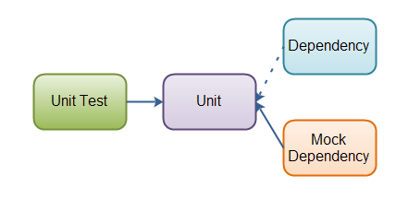
Spring Framework (IOC)
Everything in the IOC Container
Creates loosely coupled application through Dependency Injection
Easily Tested
More understandable code
Easier changes to linked functionality.
Notes:
Spring built on the IOC Container
Bucket to store all things spring

Slide 12
Goals
Overview of Spring Framework
Deeper dive into specific modules
Spring Boot
Spring MVC
Spring Data
Spring Security
Questions and Live Spring Demo

Slide 13

Spring Boot
Stand-alone, production-grade Spring-based Applications that you can "just run“
Notes:
One of the newest spring projects
Logging, caching, etc
Not used in Admin Tool

Slide 14
Spring Boot
Create stand-alone Spring applications
Embed Tomcat, Jetty or Undertow directly (no need to deploy WAR files)
Provide opinionated 'starter' POMs to simplify your Maven configuration
Automatically configure Spring whenever possible
Provide production-ready features such as metrics, health checks and externalized configuration
Absolutely no code generation and no requirement for XML configuration
Notes:
Create stand-alone Spring applications
Embed Tomcat, Jetty or Undertow directly (no need to deploy WAR files)
-Get code running very quickly with no deployment dependencies
Provide opinionated 'starter' POMs to simplify your Maven configuration
Automatically configure Spring whenever possible
Provide production-ready features such as metrics, health checks and externalized configuration
Absolutely no code generation and no requirement for XML configuration

Slide 15
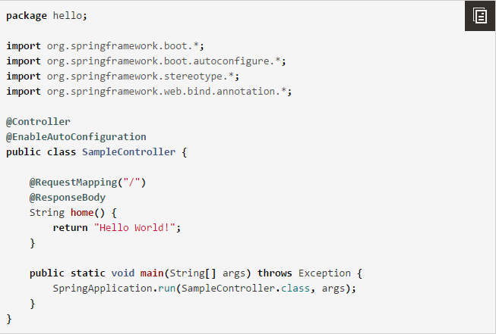
Spring Boot (Example)

Slide 16

Spring MVC
Provides model-view-controller architecture and ready components that can be used to develop flexible and loosely coupled web application
Notes:
One of the longest standing projects.
I believe included by default with spring framework
Used in Admin tool heavily

Slide 17
Spring Web (MVC)
Highly flexible data binding
No more Response objects that mean nothing
Clear separation of roles
Clean Code / Best Practices
Advanced integration with various spring modules
Notes:
Highly flexible data binding
-Let spring handle response status population (200, 500, etc)
Clear separation of roles
-Annotations to separate logic into organized structure
@Service, @Controller, etc
Advanced integration with various spring modules
-Spring Security

Slide 18
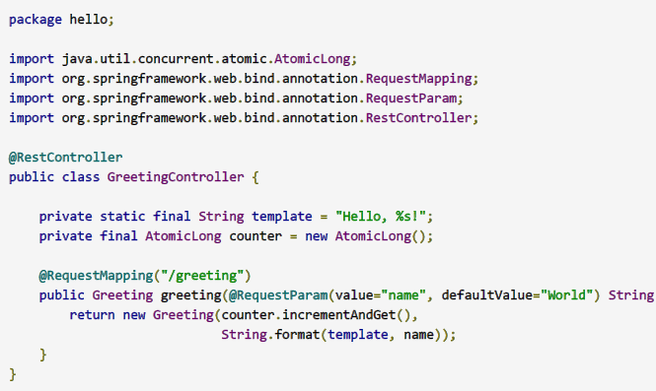
Spring Web (MVC) (Example)
Notes:
Restful controller, auto configured to use spring boot provided impl

Slide 19

Spring Data
Provide a familiar and consistent, Spring-based programming model for data access while still retaining the special traits of the underlying data store.
Notes:
Been around for a while
Used heavily in Admin Tool

Slide 20
Spring Data
Powerful repository and custom object-mapping abstractions
Implementation domain base classes providing basic properties
Dynamic query derivation from repository method names
Support for transparent auditing (created, last changed)
Possibility to integrate custom repository code

Slide 21
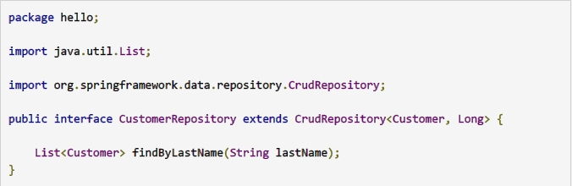
Spring Data (Example)

Slide 22

Spring Security
Powerful and highly customizable authentication and access-control framework. It is the de-facto standard for securing Spring-based applications.
Notes:
how easily it can be extended to meet custom requirements

Slide 23
Spring Security
Comprehensive and extensible support for both Authentication and Authorization
Protection against attacks like session fixation, clickjacking, cross site request forgery, etc
Servlet API integration
Optional integration with Spring Web MVC

Slide 24
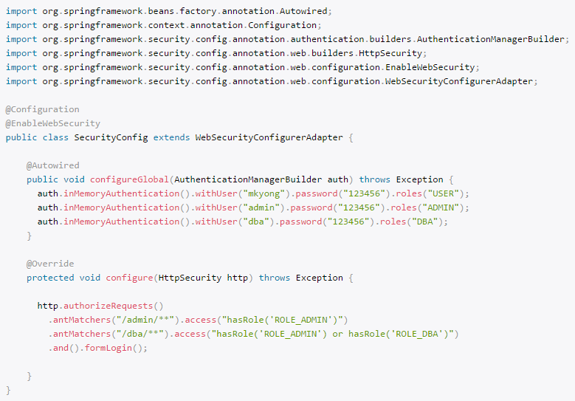
Spring Security (Example)

Slide 25
Goals
Overview of Spring Framework
Deeper dive into specific modules
Spring Boot
Spring MVC
Spring Data
Spring Security
Questions and Live Spring Demo

Slide 26
Questions

Slide 27
Demo

Slide 28
End

Slide 29

Dropped Call

